Slide 1
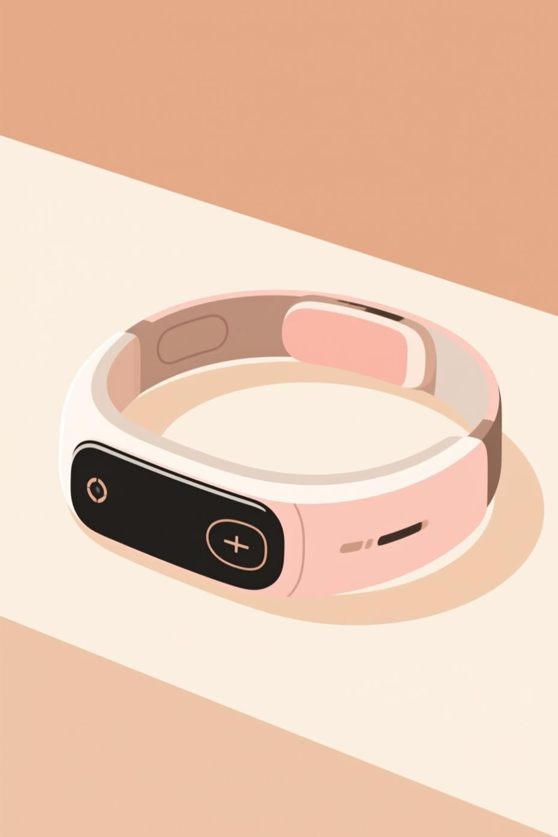
Revolutionizing Healthcare: The Rise of IoT-Based Portable Health Monitoring Systems
Discover how Internet of Things technology is transforming patient care through continuous, real-time health monitoring that's accessible anywhere, anytime.
By:- Gaurav Singh Rana (3) (12324801)
Vivek Kumar (7) (12325500)
Hemant Kumar (4) (12324886)
Subham Kumar (10) (12326211)

Slide 2
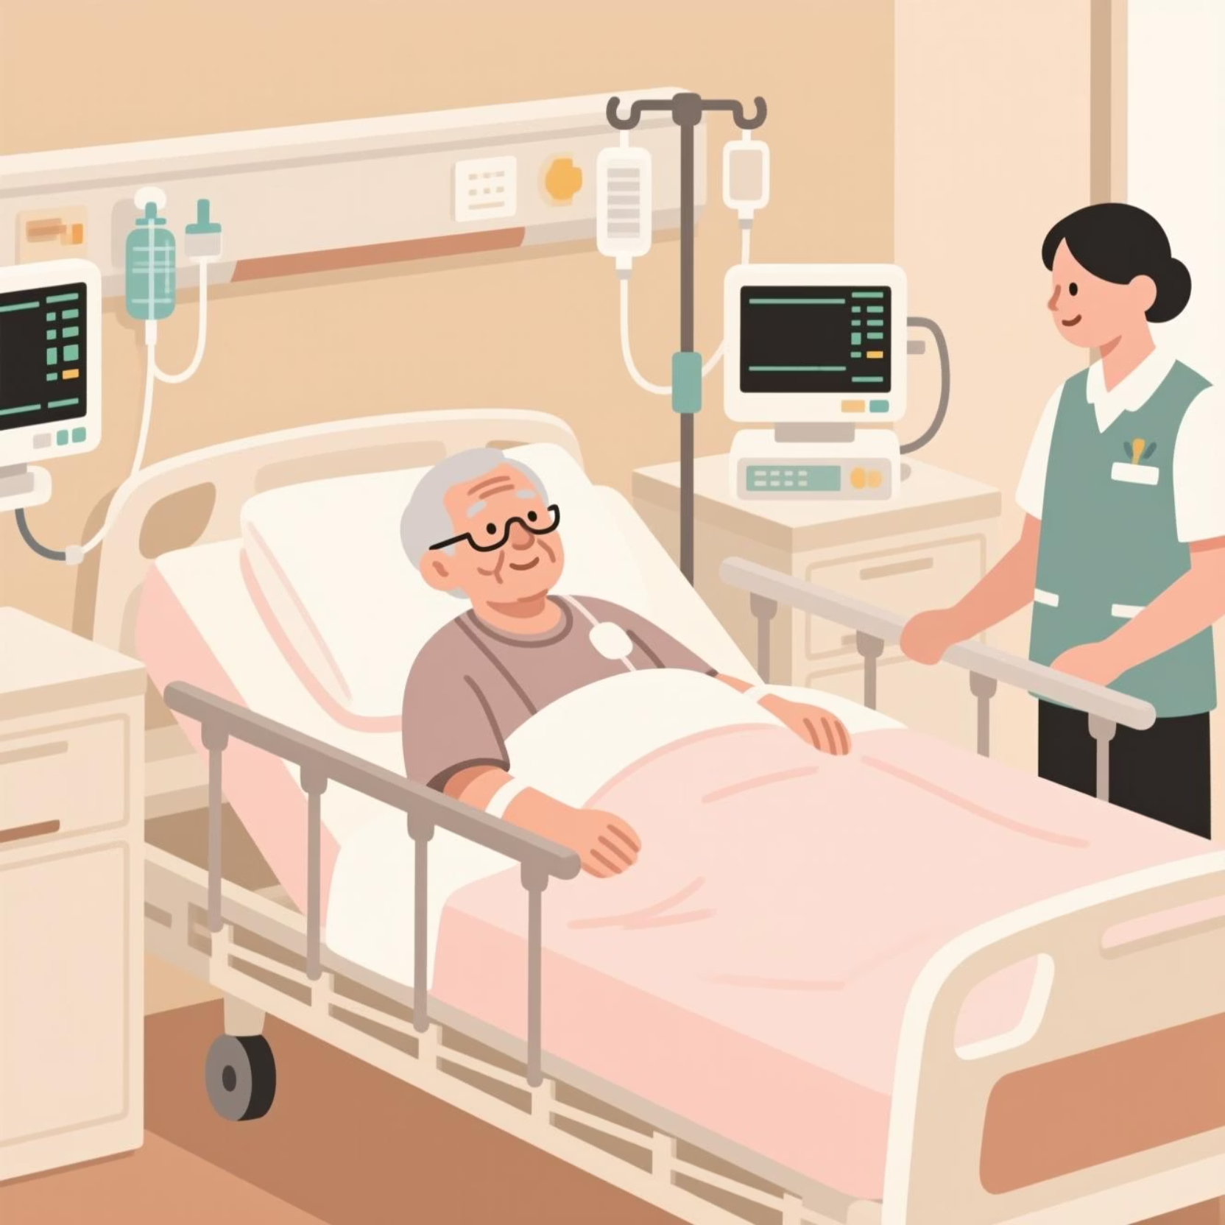
The Healthcare Challenge: A Growing Need
Rising Demand, Limited Resources
Aging populations and the rise of chronic diseases are straining healthcare systems worldwide. Traditional healthcare models struggle to provide continuous monitoring due to high costs, limited infrastructure, and the complexity of managing growing patient populations.
The need for innovative, scalable solutions has never been more urgent as healthcare providers seek ways to deliver quality care beyond hospital walls.

Slide 3




What is an IoT-Based Health Monitoring System?
Sensor Technology
Wireless Data Transmission
Real-Time Insights
Advanced sensors continuously measure vital physiological parameters including heart rate, body temperature, blood oxygen levels (SpO2), and more.
Health data is collected wirelessly and transmitted in real-time to cloud platforms for immediate analysis and remote monitoring by healthcare providers.
Instant access to health metrics enables proactive care, early intervention, and continuous patient engagement through mobile applications.

Slide 4




Key Components: The Technology Behind the System
Advanced Sensors
ESP32 Microcontroller
Communication Module
MAX30102: Pulse oximeter for heart rate and SpO2
The powerful ESP32 serves as the brain of the system, processing sensor data and managing communication protocols with exceptional efficiency and reliability.
Wireless connectivity via Wi-Fi or GSM ensures seamless data transmission to cloud platforms and mobile applications for instant access.
DHT22: Temperature and humidity monitoring
NEO6M GPS: Location tracking for emergencies
Critical Alert System: When BPM exceeds 120, SpO2 drops below 85%, or temperature rises above 39°C, the Blynk application automatically sends a critical health alert email with the patient's GPS location for immediate emergency response.

Slide 5
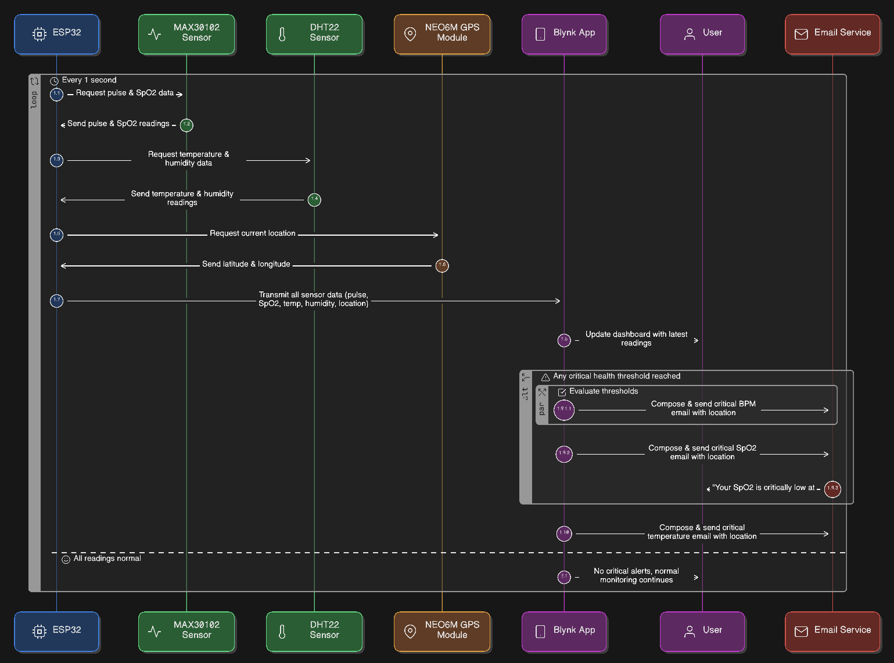
Block Diagram:-

Slide 6
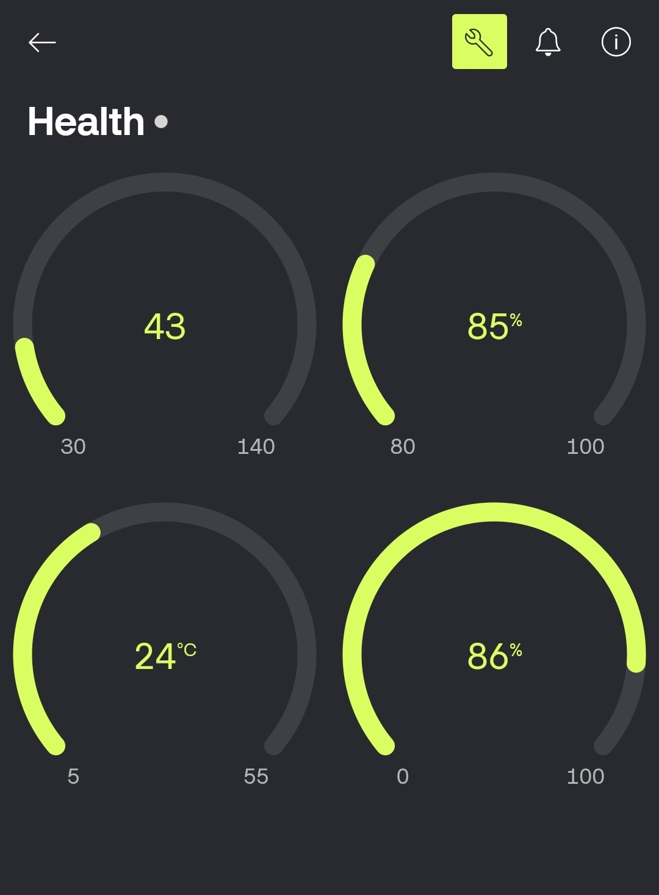
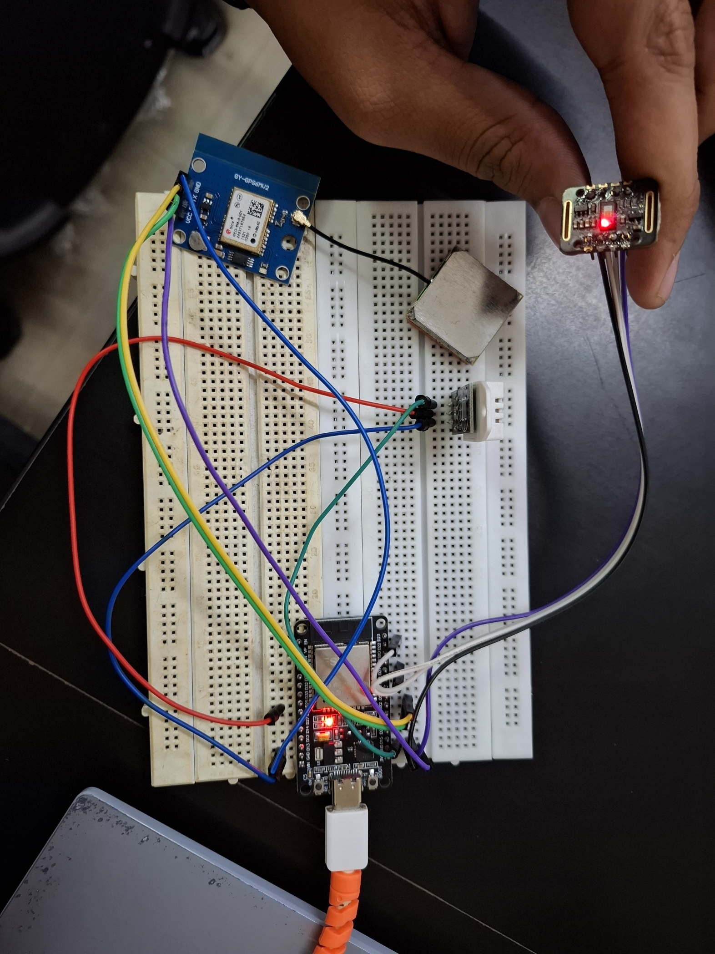
Circuit And Blynk Interface

Slide 7
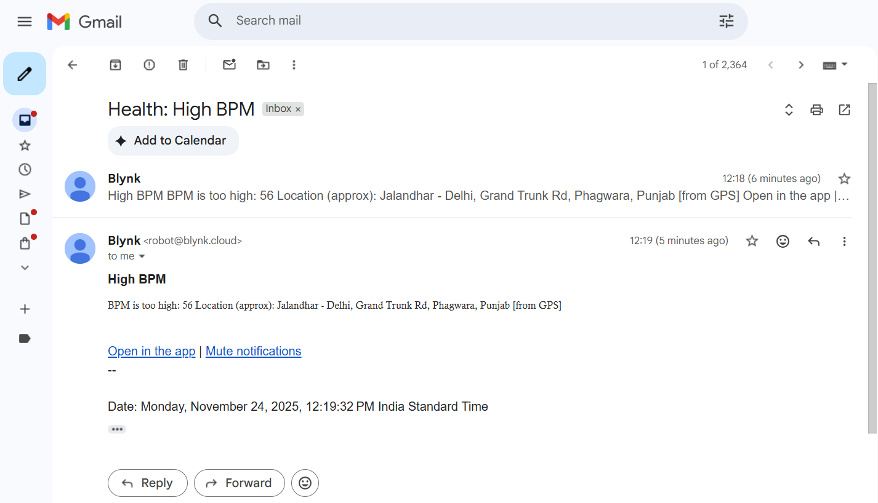
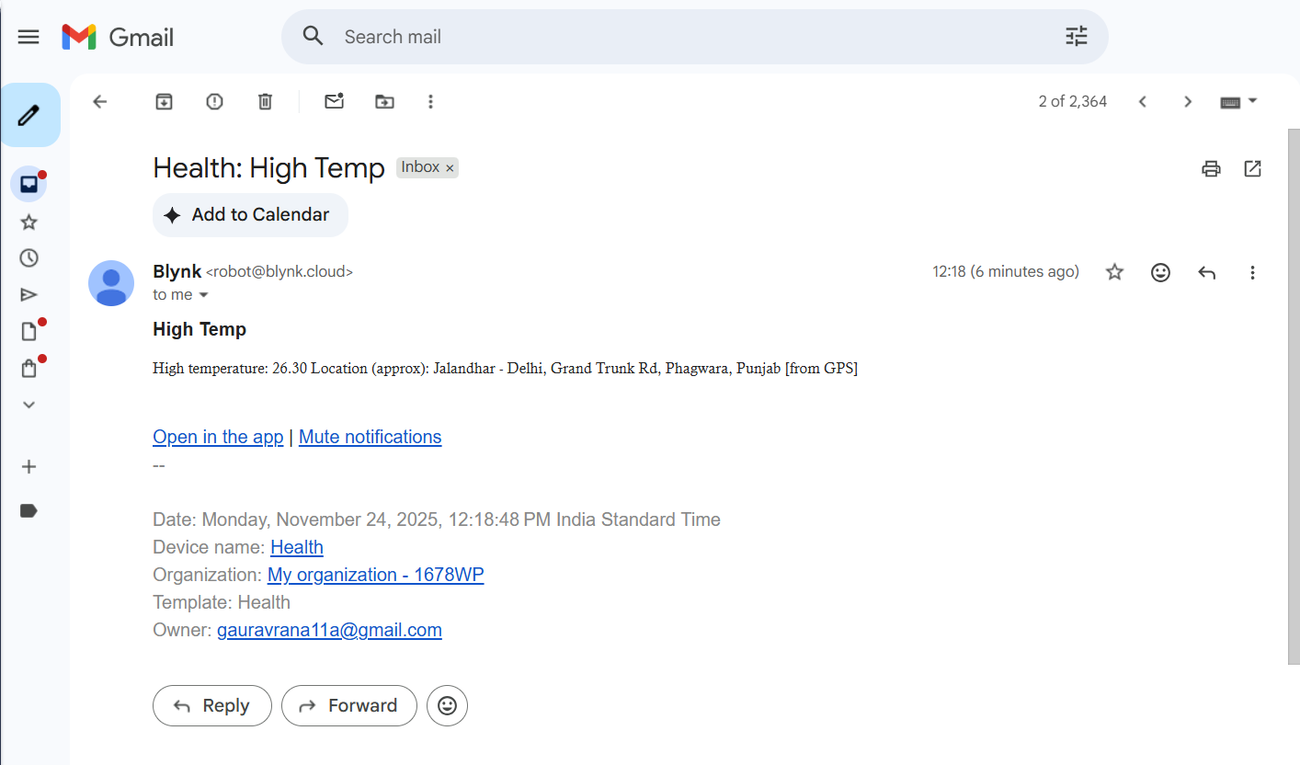
Alert System

Slide 8
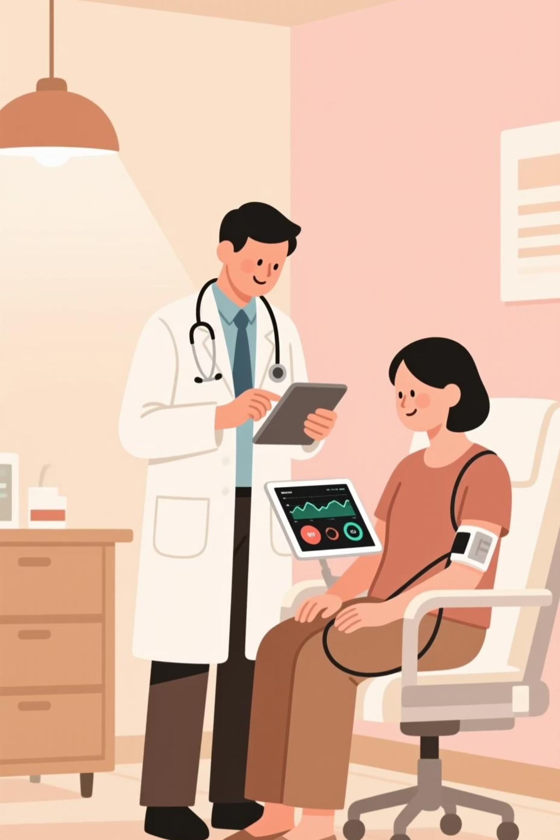



Benefits: Transforming Patient Care
Remote Patient Monitoring
Healthcare providers can monitor patients from anywhere, breaking down geographical barriers and extending care beyond traditional clinical settings.
Early Detection
Real-time data analysis enables early identification of health issues, allowing for timely interventions before conditions become critical.
Better Outcomes, Lower Costs
Continuous monitoring improves patient outcomes while significantly reducing healthcare costs through prevention and reduced hospital readmissions.

Slide 9
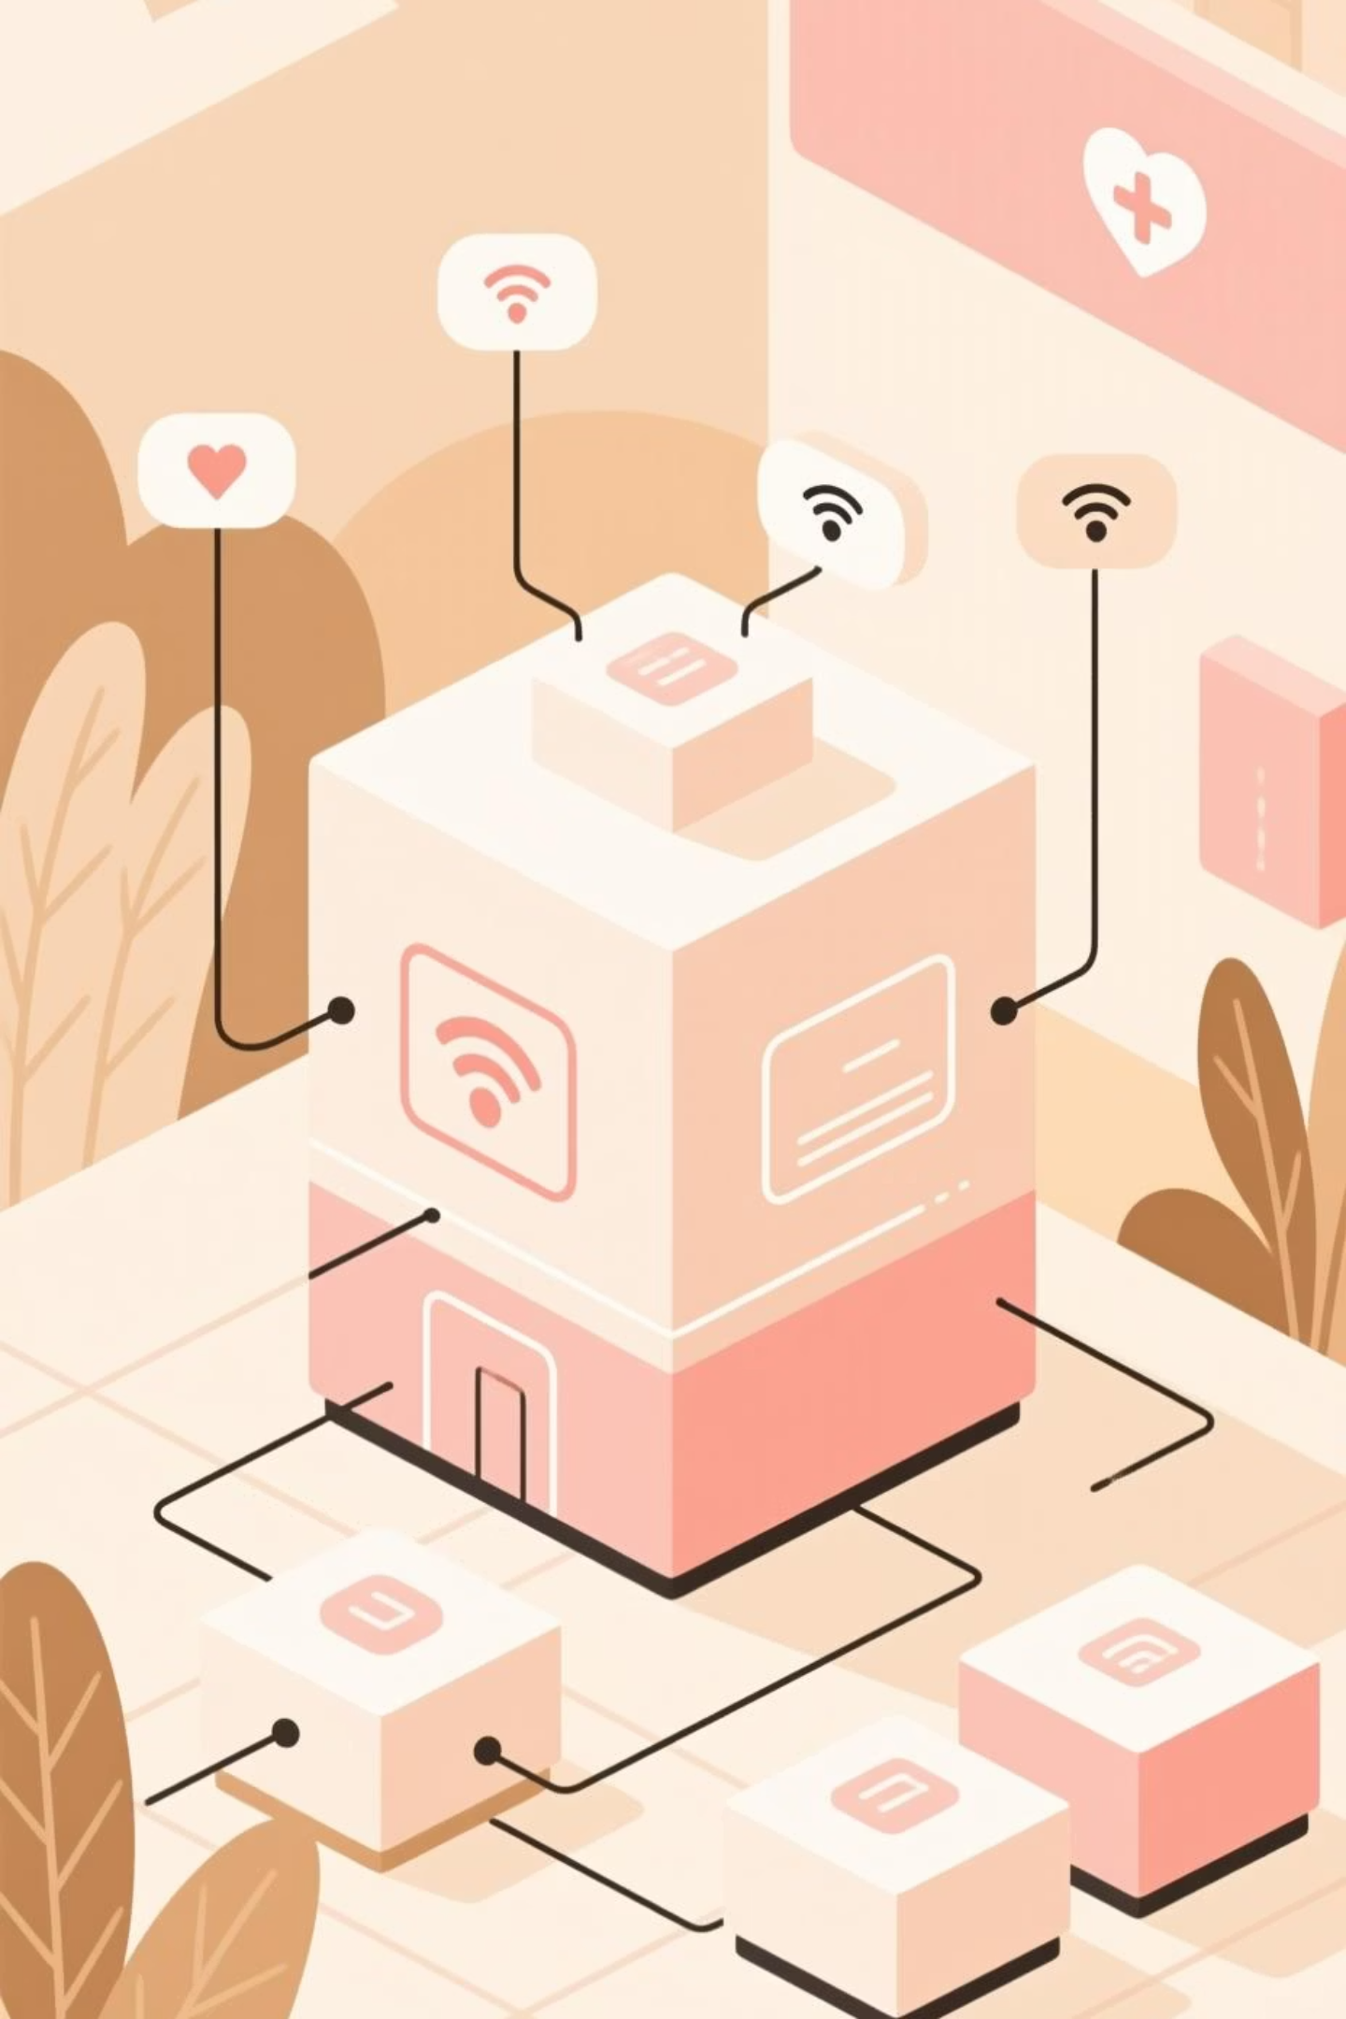
System Architecture: How It All Connects
Data Collection
Processing & Transmission
Analysis & Alerts
Sensors gather vital signs and environmental data continuously.
Cloud platform analyzes data and triggers alerts when needed.
ESP32 processes data and transmits via wireless protocols.

Slide 10

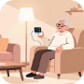

Applications: Where IoT Shines
Hospital Settings
Home Healthcare
Daily Wellness
Continuous monitoring of patients in ICUs and general wards, freeing up healthcare staff while maintaining vigilant oversight of critical vital signs.
Empowering elderly individuals and those with chronic conditions to live independently while receiving professional monitoring and support remotely.
Fitness tracking and wellness monitoring for health-conscious individuals, providing insights into activity levels, sleep patterns, and overall health metrics.

Slide 11
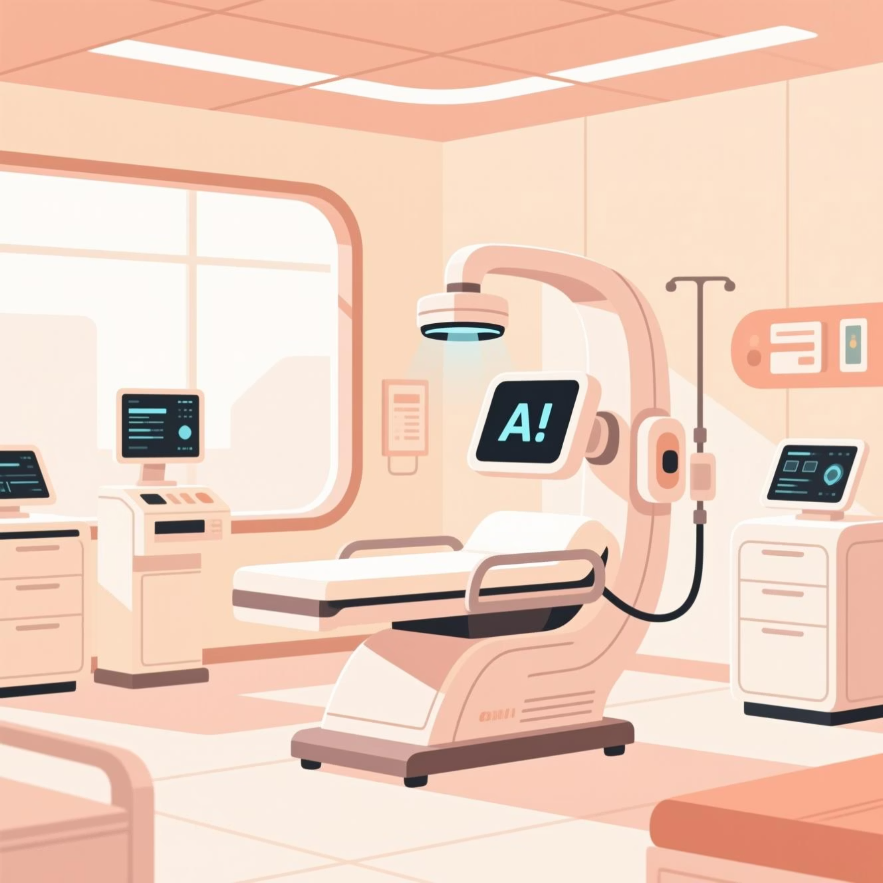
Challenges and Future Directions
Current Challenges
The Road Ahead
1
Data Security & Privacy
The future of IoT health monitoring is bright, with emerging technologies like AI-powered predictive analytics, miniaturized sensors, and improved interoperability between devices and healthcare systems.
Protecting sensitive health information remains a critical concern requiring robust encryption and compliance with healthcare regulations.
2
Portability & User Experience
Improving device comfort, battery life, and ease of use to ensure consistent patient adoption and long-term engagement.
Next Steps: Integration with electronic health records, enhanced machine learning algorithms for personalized care, and expansion into underserved communities worldwide.
Next Steps: Integration with electronic health records, enhanced machine learning algorithms for personalized care, and expansion into underserved communities worldwide.

